Slide 1
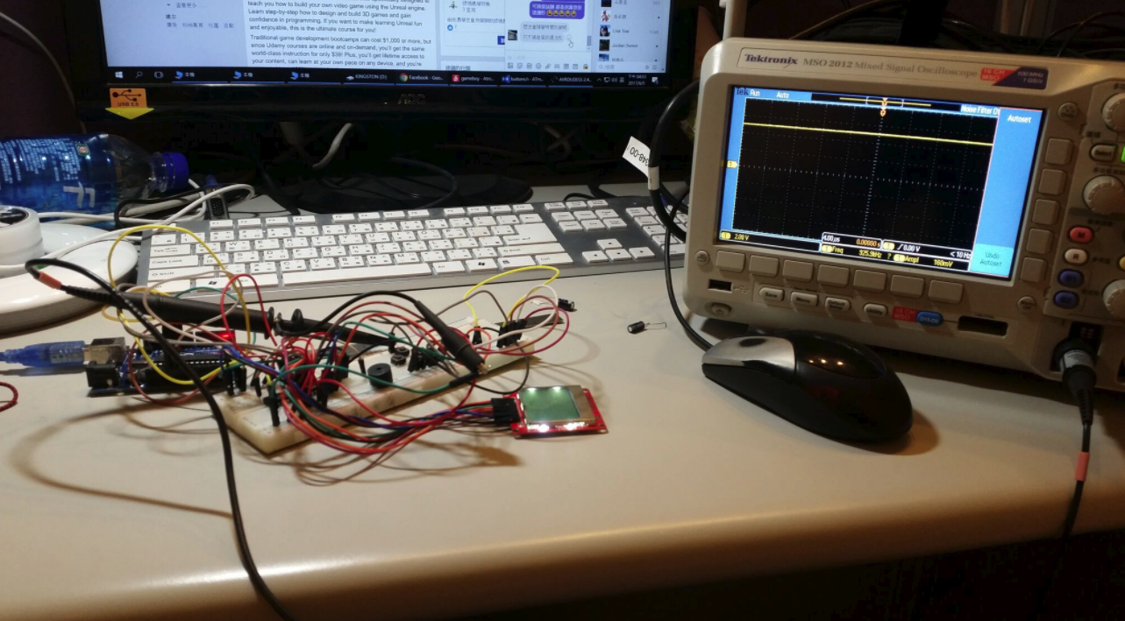
2017 MCU Final Project
Liu, An-Chi & Chang, Che-Yuan BIME, NTU, Taiwan

Slide 2
Handheld Game Console
We made a

Slide 3
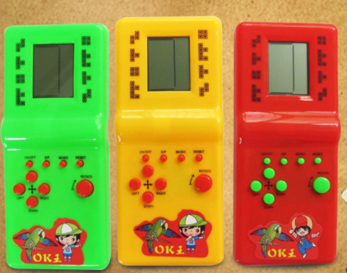
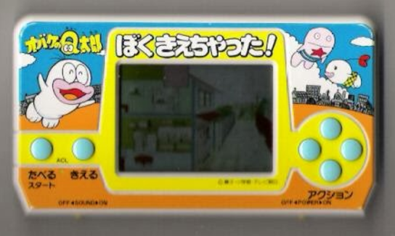
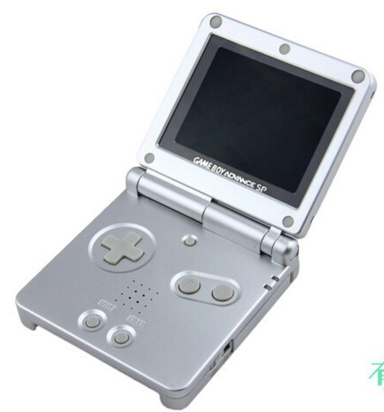
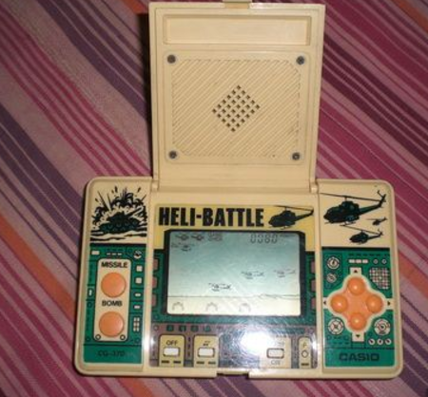

Slide 4
Components
MCU
LCD
Buttons
Others
Somewhere

Slide 5
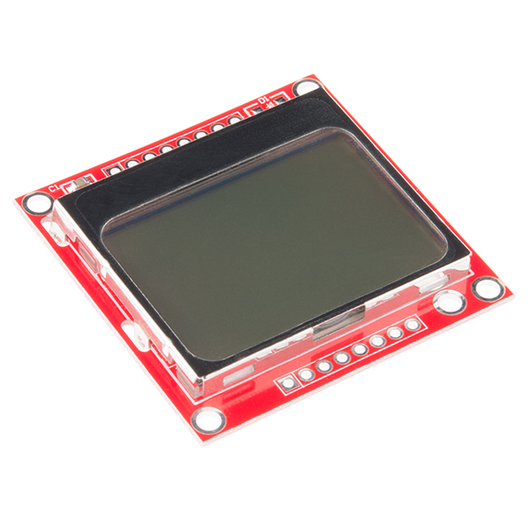
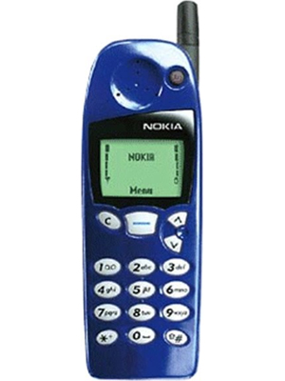
LCD
Nokia5110 LCD

Slide 6
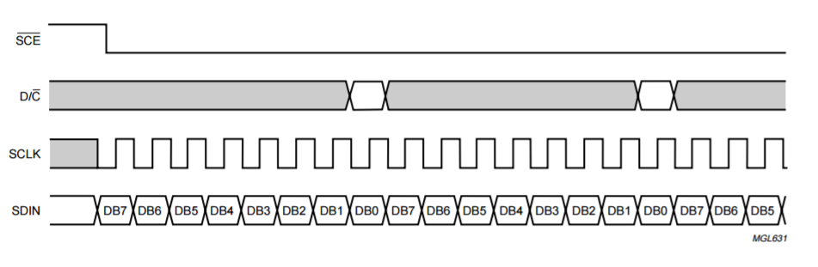
Nokia5110
48 × 84 pixels matrix
PCD8544 Controller
CMOS
Data Sheet

Slide 7
Pin No. | Pin Label | Pin Function | I/O | Notes
1 | VCC | Positive power supply | Input | Supply range is between 2.7V and 3.3V
2 | GND | Ground | Input
3 | SCE | Chip select | Input | Active low
4 | RST | Reset | Input | Active low
5 | D/C | Mode select | Input | Select between command mode (low) and data mode (high).
6 | DN(MOSI) | Serial data in | Input
7 | SCLK | Serial clock | Input
8 | LED | LED backlight supply | Input | Maximum voltage supply is 3.3V.

Slide 8
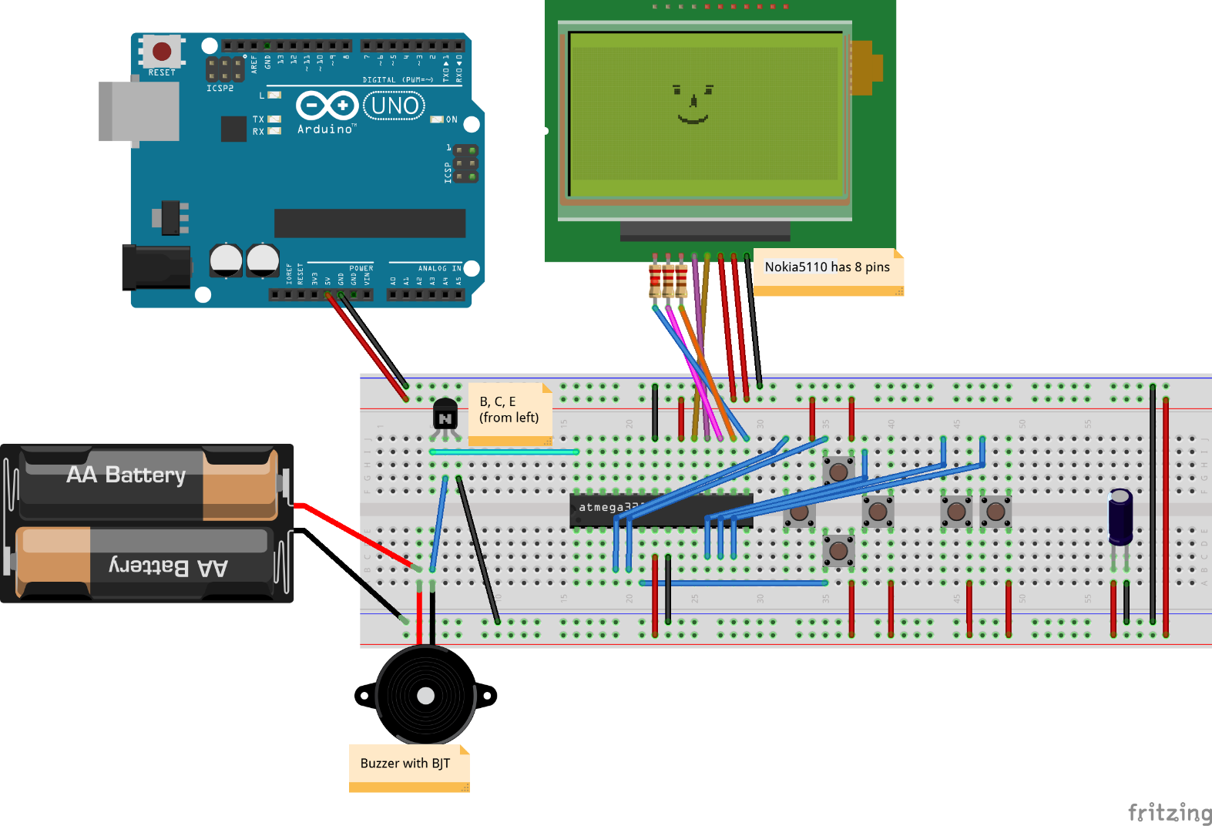
Circuit Diagram

Slide 9
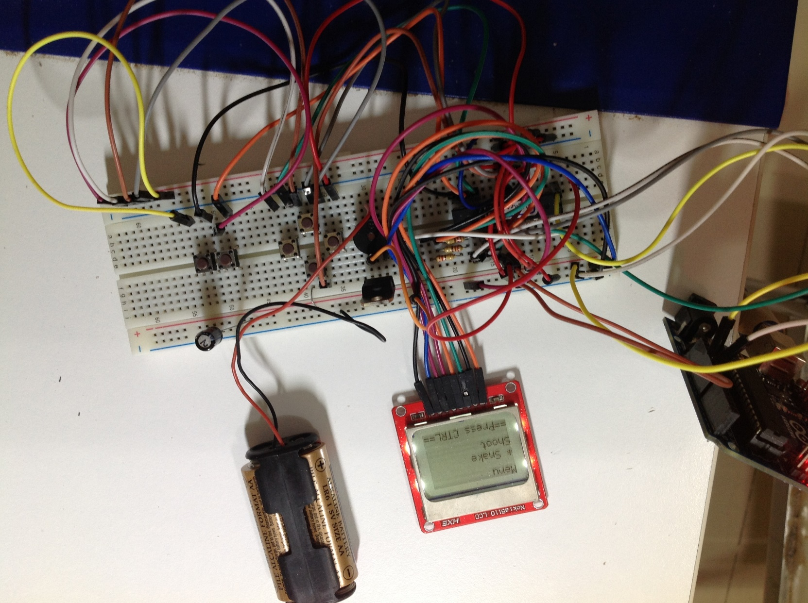
Photo

Slide 10
Video
https://www.dropbox.com/s/jr5x41fuszlm30k/ATmega328P_Nokia5110_gameboy.mov?dl=0
Adjust the volume

Slide 11
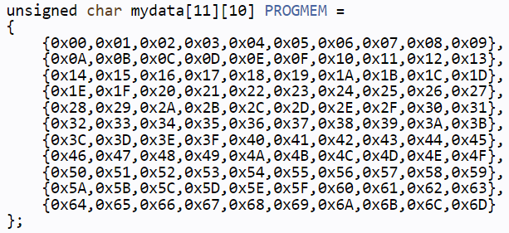
Limitations & Problems
RAM
Many AVRs have limited amount of RAM in which to store data, but may have more Flash space available.
Memory
32 KB
CPU Speed

Slide 12
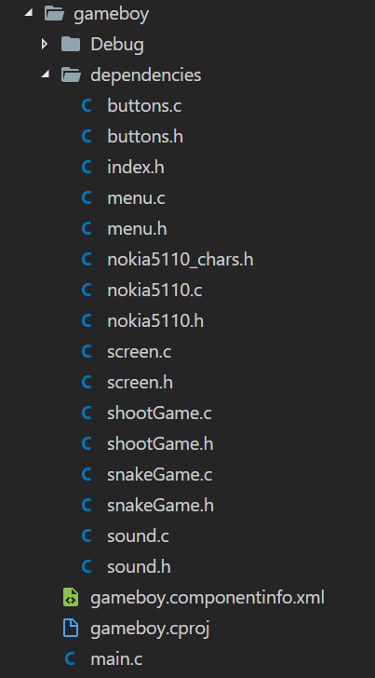
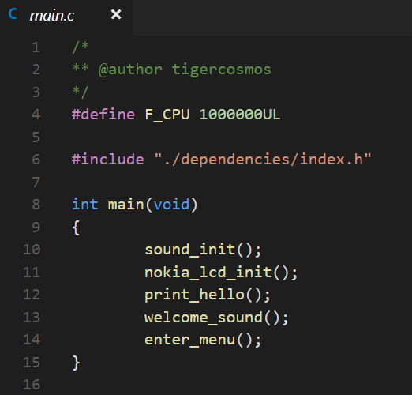
Architecture

Slide 13
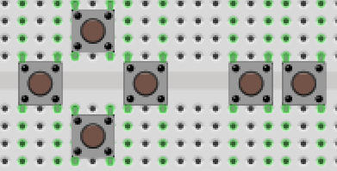
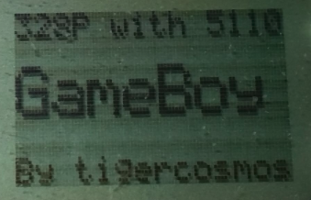
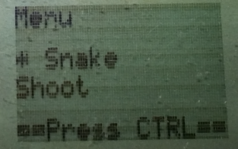
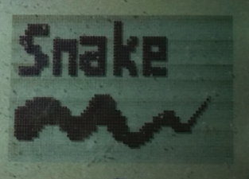
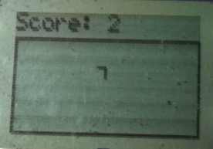
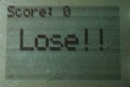
Game Process
Up
Fire
Left
Right
Ctrl
Down
Menu: Up, Down
Welcome
Press Ctrl
Press Ctrl
Game Cover

Slide 14
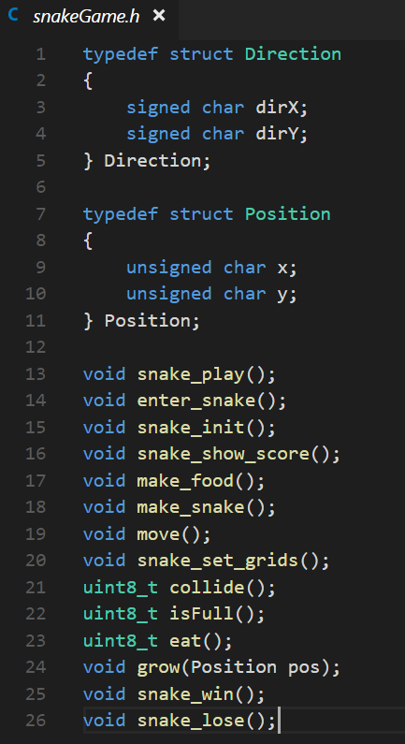
Game Logic
Snake snake
See snakeGame.h
See snakeGame.c
Feel free to ask me
Special
Circular queue as snake body
Use buttons clicks as random seed

Slide 15
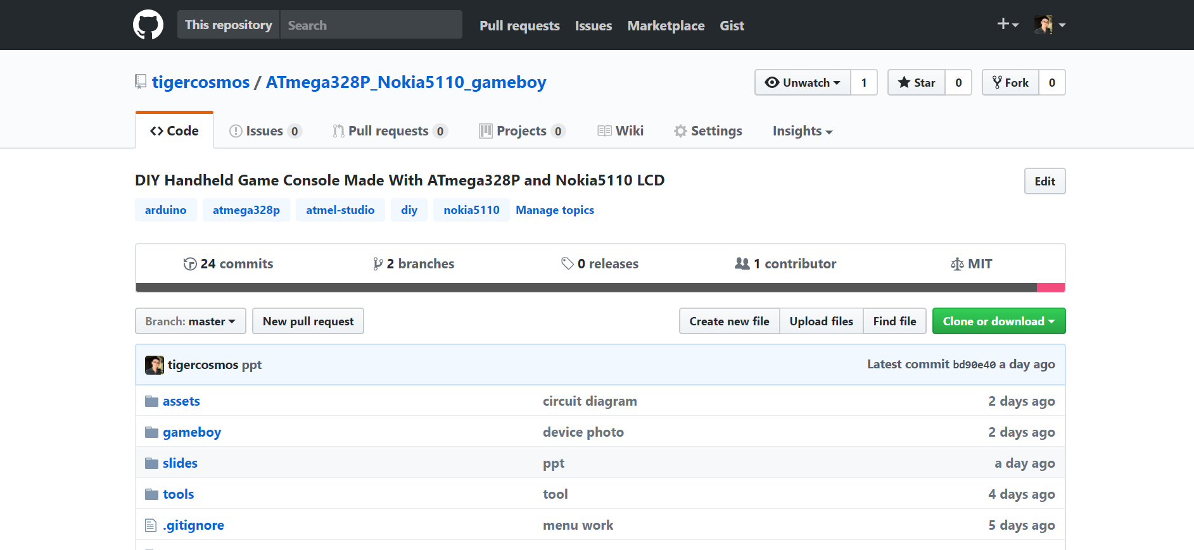
DIY Yourself
https://github.com/tigercosmos/ATmega328P_Nokia5110_gameboy

